Slide 1
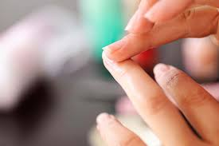
Early Stage disease Diagnosis Using Human Nail in image Processing
Team Members: Pavithra.V - 211417104182
Navanisha.D - 211417104161
Reshika.D - 211417104224
Guide Details : Mrs.A.Kanchana M.E.
Assistant Professor.

Slide 2
INTRODUCTION
In healthcare domain many diseases can be predicted by observing color of human nails.
Doctors observe nails of patient to get assistance in diseases identification .
The need of system to analyze nails for diseases prediction is because human eye is having subjectivity about colors, having limitation in resolution and small amount of color change in few pixels on nail would not be highlighted to human eyes which may lead to wrong result where as computer recognizes small color changes on nail. .

Slide 3
The proposed system will extract color feature of human nail image for disease prediction
The system is focusing on image recognition on the basis of human nail color analysis.
Many diseases could be identified by analyzing nails of human hands.
In this system human nail image is captured using camera. Captured image is uploaded to our system and region of interest from nail area is selected from uploaded image manually.

Slide 4
Selected area is then processed further for extracting features of nail such as color of nail.
This color feature of nail is matched using simple matcher algorithm for diseases prediction .
In this way the system is useful in prediction of diseases in their initial stages. .

Slide 5
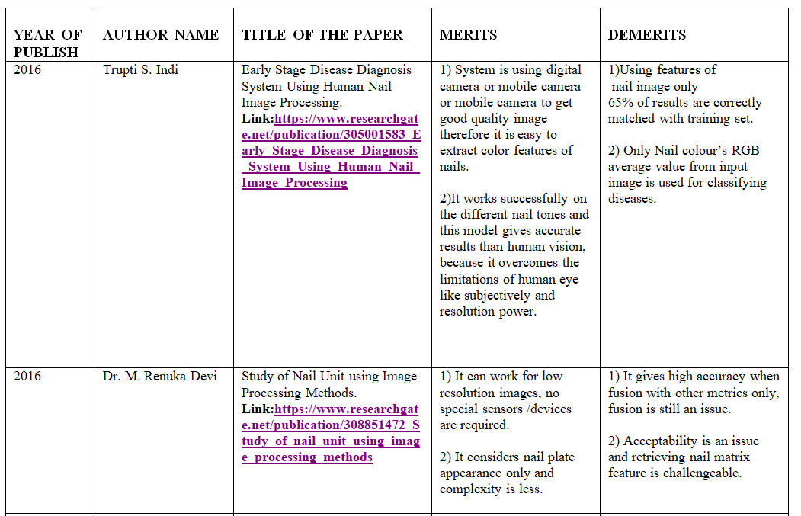
LITERATURE SURVEY

Slide 6
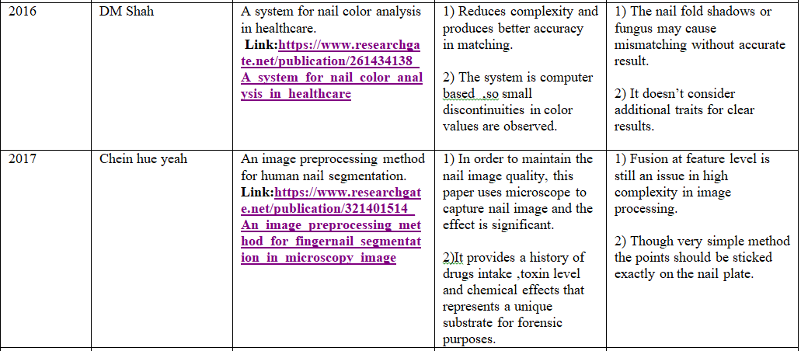

Slide 7
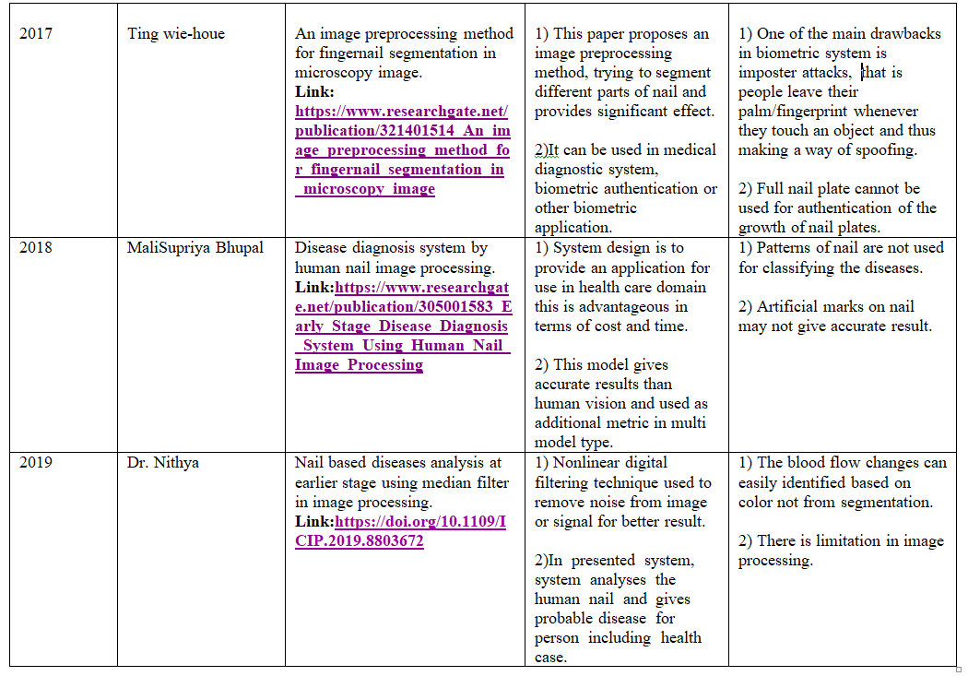

Slide 8
PROBLEM STATEMENT
Human nail can be used for the prediction of various systemic and dermatological diseases.
The proposed system – Nail Image Processing System helps us to create a model which can perform the analysis of human nail and thereby help us in predicting various diseases .
Common signs that may be noticeable around the nail are discoloration of nail to black, white, yellow or green, thickening of nail, dry or scaly skin around the nail..

Slide 9
This project contend a deep convolutional network to classify diseases from images.
This work has been tested on our dataset and it results in great performance in feature extraction .
This proposed system will help the doctors in the early diagnosis of diseases.

Slide 10
TECHNOLOGY STACK
DOMAIN :Deep Learning
FRONT END: Python Idle
BACK END: Tensor Flow
LIBRARIES: Open CV

Slide 11
SYSTEM ARCHITECTURE
Input test image
Preprocessing
Features extraction
Dataset images
Features extraction
Trained all features
CNN Classifier
Classified Stages

Slide 12
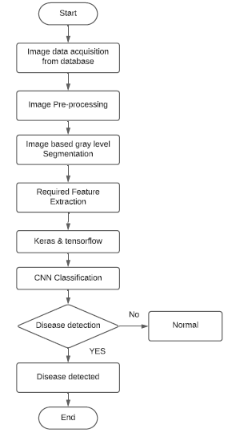
SYSTEM DESIGN a)Flow diagram

Slide 13
B)USE CASE DIAGRAM
Dataset
Input image
Data analysis
Classification
user
Show result

Slide 14
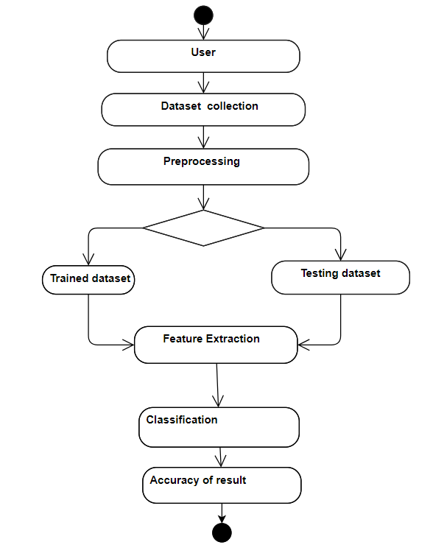
C)ACTIVITY DIAGRAM

Slide 15
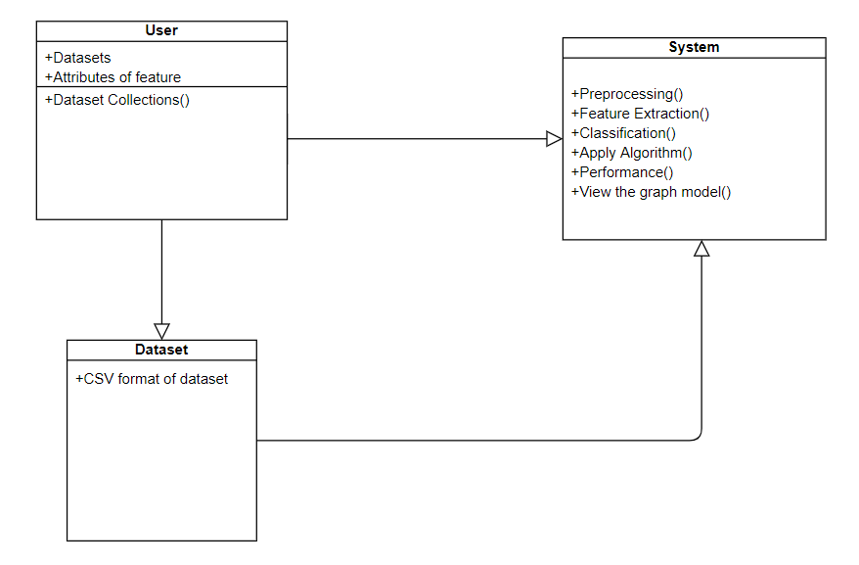
D)CLASS DIAGRAM

Slide 16
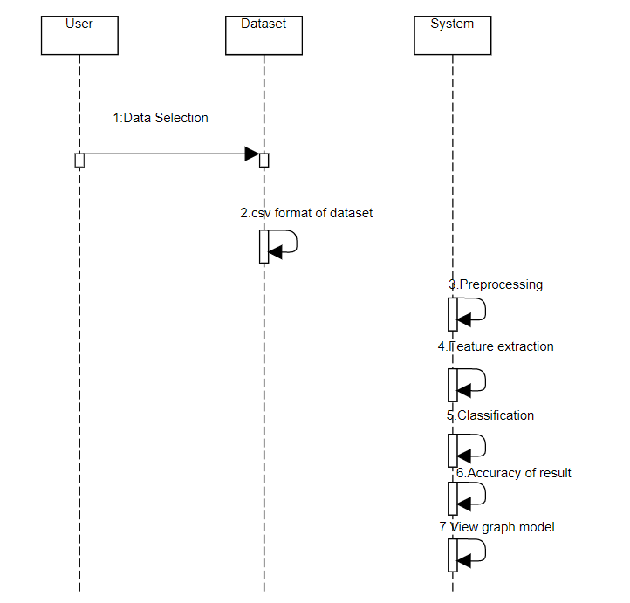
E)SEQUENCE DIAGRAM

Slide 17
MODULE DESCRIPTION
Image acquisition
Pre-processing
Data Labelling
Feature analysis
Convelutional Neural Network

Slide 18
Image Acquisition
Image acquisition in image processing is collection of dataset.
It is the action of retrieving both normal and abnormal nail image for further analysis.
Which are all having either .jpg , .png , .bmp format.

Slide 19
Pre-processing
Image pre-processing is the term for operation on images at lowest level of operation.
The human nail image is given as input to the pre-processor.
If the image are of poor contrast , the pre-processor will enhance the contrast for clear classification type.
Steps involved:
Acquire the dataset
Resizing
Conversion
Filtering

Slide 20
Data Labelling
The steps followed in data Labelling are:
Labelling
Assigning Classes
Allocating Index
Setting the Path

Slide 21
Feature analysis
Feature analysis consists of:
DWT (Discrete Wavelet Transform)

Slide 22
DWT
Discrete Wavelet Transform is used in lossless image compression of gray level image.
High quality images that require large storage are to be compressed.
DWT transforms a discrete signal . L represent the low-pass filtered signal L(low frequency)allows the perfect reconstruction of original Image.

Slide 23
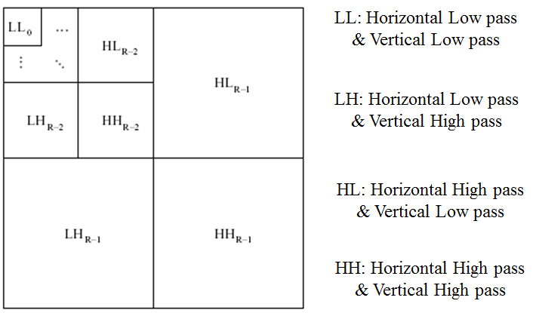
DWT Structure

Slide 24
STEPS:
1. Digitize the source image into signal.
2. Decompose signal to wavelet(sub bands) LL,LH,HL,HH
3. DWT retains images from LL to produce next level of decomposition , because the low frequency images has finer frequency and time resolution than high frequency images.
4. For each level of decomposition DWT produces 4 images and size is reduced to 1/4 of original image.

Slide 25
CNN CLASSIFATION:
CNNs are a class of Deep Neural Networks that can recognize and classify particular features from images and are widely used for analysing visual images.
Their applications can be seen widely in the medical images analysis.
The term ‘Convolution” in CNN denotes that two images can be represented as matrices which are multiplied to give an output that is used to extract features from the image.

Slide 26
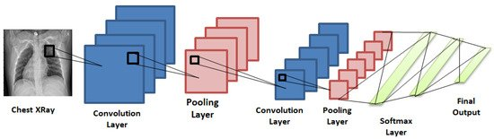
CNN DIAGRAM

Slide 27
TESTING
The dataset contains a test folder and in a test.csv file, the details related to the image path and their respective class labels are specified.
The image path and labels are extracted using pandas.
Then to predict the model, the images are resized to 30×30 pixels and numpy array containing all image data are made. From the sklearn.metrics, the confusion_matrix is imported and observed how the model predicted the actual labels.
As a result 95% accuracy of the model is achieved

Slide 28
TEST CASES
The 3 classes with which the model is tested are,
1)Normal
2)Melanoma
3)Onycholysis

Slide 29
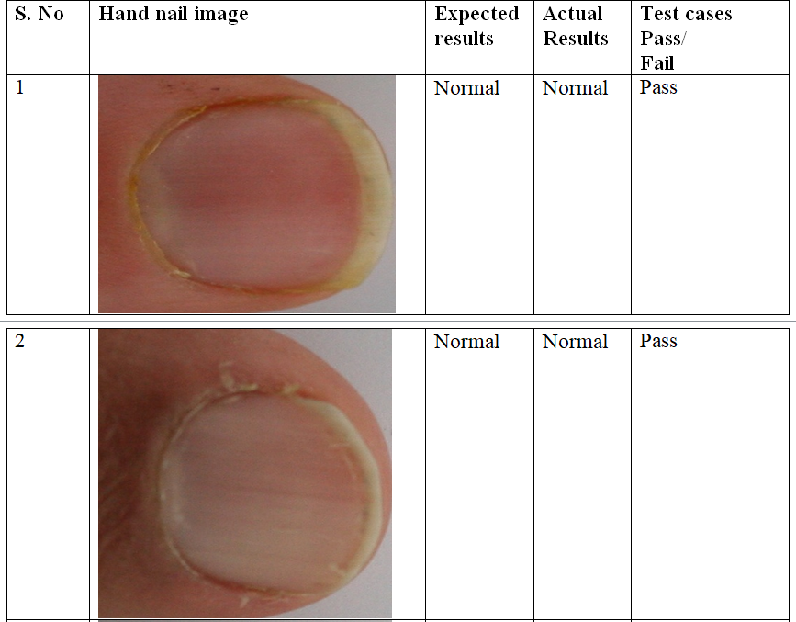
Test case:1Normal

Slide 30
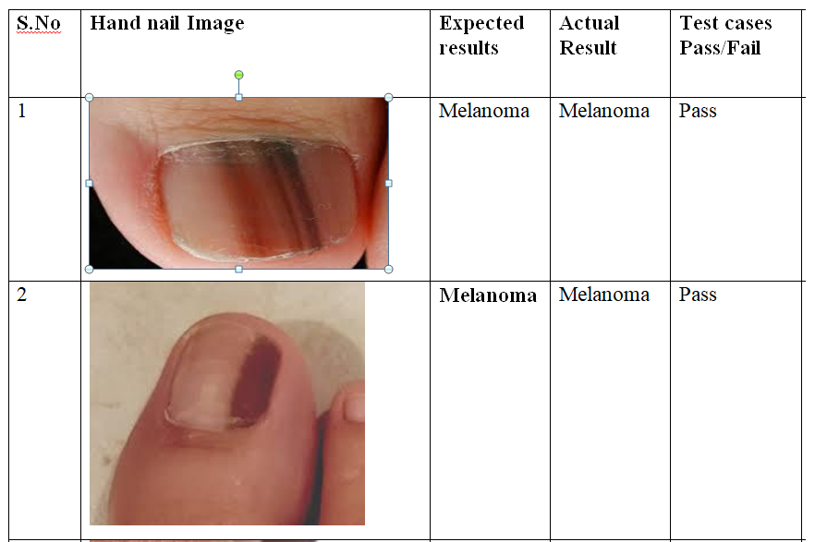
Test case:2Melanoma

Slide 31
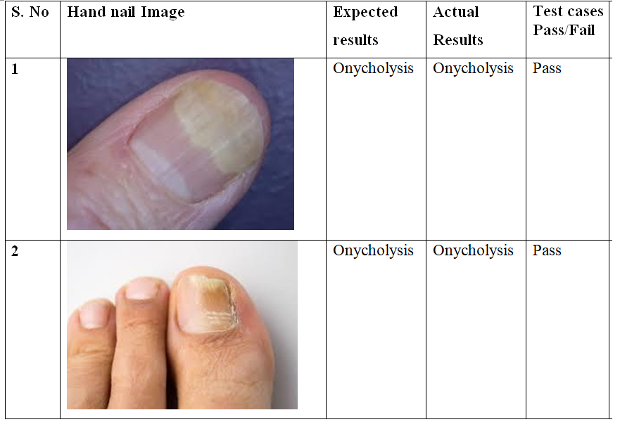
Test case :3Onycholysis

Slide 32
PERFORMANCE ANALYSIS
The performance of the CNNs trained with the nail dataset was estimated by the classification performance of the models with the normal, melanoma and Onycholysis validation datasets.
The performance of fine image selector helps in assessing image quality with the change in the illumination and reduction noise level of the images.
The levels of brightness and noise were gradually reduced to classify the image easily.
If the validation loss decreases then the accuracy will increase

Slide 33
The number of epochs should be as high as possible and terminate training based on the error rates.
An epoch is one learning cycle where the learner sees the whole training data set.
Here we are having 12 epochs and we are getting 100% validation and training accuracy.
In this experiment we found that using color feature of nail image average 75% results are correctly matched with training set data during three tests conducted and we are getting 75% accuracy on test dataset

Slide 34
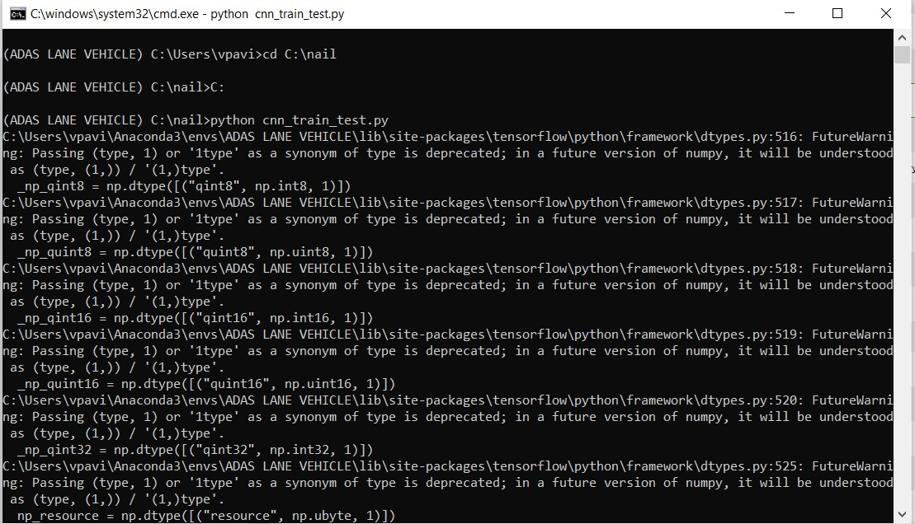
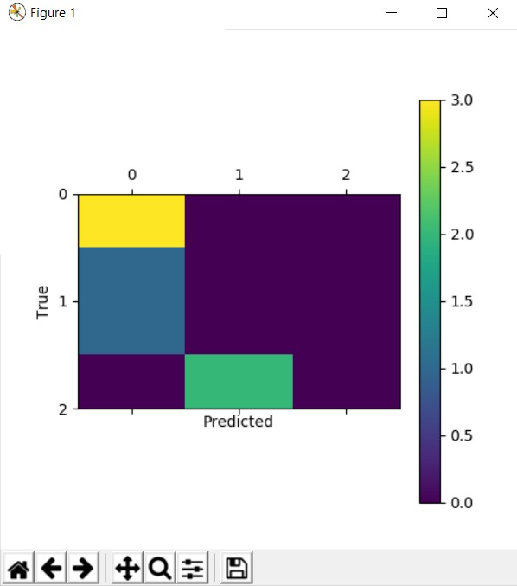
SCREENSHOTS
1)
2)

Slide 35
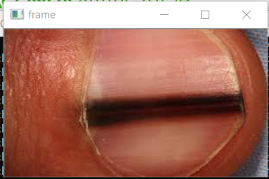
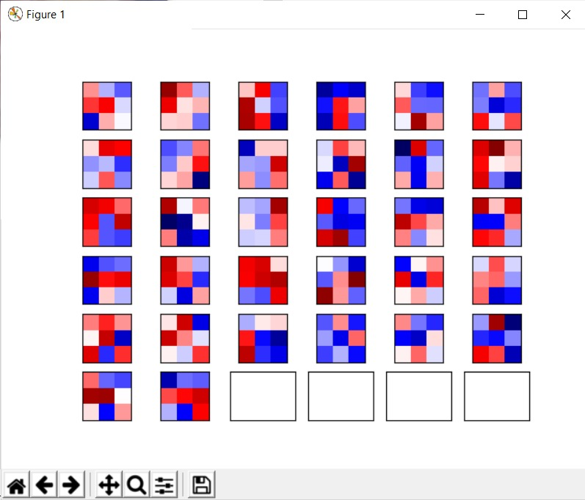
3)
4)

Slide 36
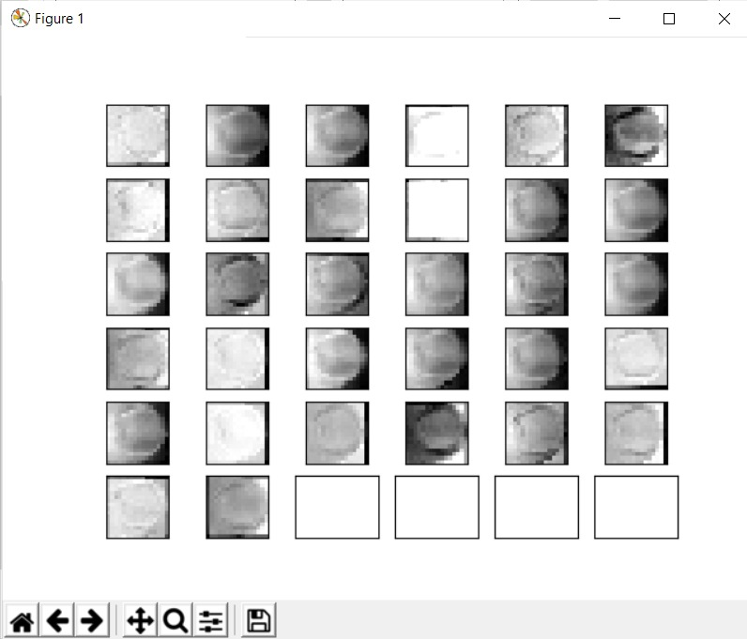
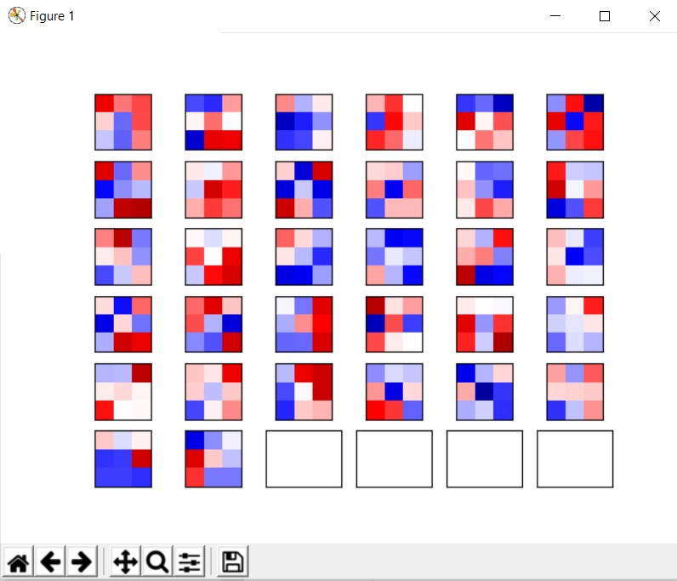
5)
6)

Slide 37
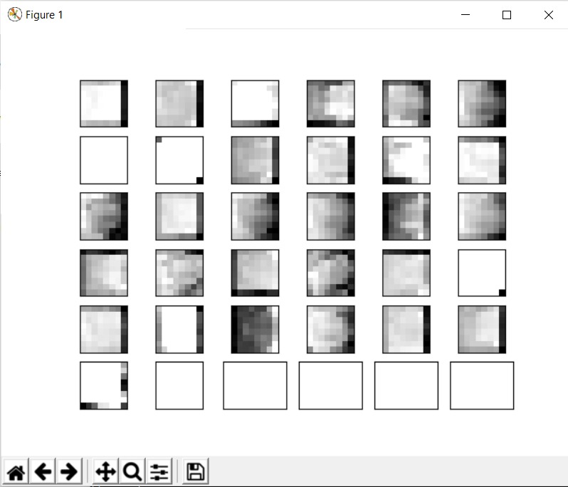
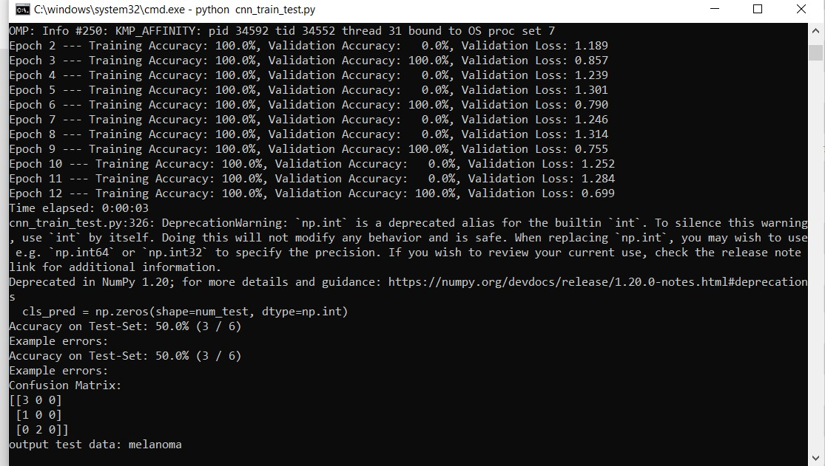
7)
8)

Slide 38
CONCLUSION
In the proposed technique we have trained a model that classifies the disease based on the pattern on the nail.
This proposed system is able to predict the disease for the respective pattern of the nail with high accuracy.
It is able to identify the small patterns also such that providing a system with higher success rate.
The limitations of the existing model are eliminated by the proposed model.

Slide 39
Moreover in the proposed system only the images of nails of fingers have been used for classifying the diseases, but in future we can combine other features of human body and predict various diseases based on the symptoms of patient and hence would be able to detect a lot of diseases with good precision and accuracy.

Slide 40
REFERENCES
[1] A. Bourquard, I. Butterworth, A. Sanchez-Ferro, L. Giancardo,L. Soenksen,
C. Cerrato, R. Flores, and C. Castro-Gonzalez, “ Analysis of white blood cell dyna -mics in nail fold capillaries,” Proceedings of the Annual International Confe -rence of the IEEE Engineering In Medicine and Biology Society, EMBS, vol. 2015-Novem, pp. 7470–7473, 2015.
[2] A. Bourquard, A. Pablo-Trinidad, I. Butterworth, Á. Sánchez-Ferro,C. Cerrato, K. Humala, M. Fabra Urdiola, C. Del Rio, B. Valles, J. M.Tucker-Schwartz, E. S. Lee, B. J. Vakoc, T. P. Padera, M. J. Ledesma-“Non-invasive detection of severe neutropenia in chemotherapy patientsby optical imaging of nailfold microcirculation,” Scientific Reports, vol. 8, no. 1, pp. 1–12, 2018. Carbayo, Y. B. Chen, E. P. Hochberg, M. L. Gray, and C. Castro-González,
[3] M. Etehad Tavakol, A. Fatemi, A. Karbalaie, Z. Emrani, and B.-E. Erlandsson, “Nailfold Capillaroscopy in Rheumatic Diseases: Which Parameters Should Be Evaluated?,” BioMed research international, vol. 2015, p. 974530, 2015.

Slide 41
[4] M. Cutolo, A. Sulli, M. E. Secchi, S. Paolino, and C. Pizzorni, “Nailfold capillaroscopy is useful for the diagnosis and follow-up of autoimmune rheumatic diseases. A future tool for the analysis of microvascular heart involvement?,” Rheumatology, vol. 45, pp. iv43–iv46, oct 2006.
[5] O. Wilhelmsson, “Evaluation of video stabilisation algorithms in dynamiccapillaroscopy,” 2018.
[6] A. Karbalaie, M. Etehadtavakol, F. Abtahi, A. Fatemi, Z. Emrani, and B.-E. Erlandsson, “Image enhancement effect on inter and intra-observer reliability of nailfold capillary assessment,” Microvascular Research, vol. 120, pp. 100 – 110, 2018.

Slide 42
[7] A. Karbalaie, Z. Emrani, A. Fatemi, M. Etehadtavakol, and B.-E. Erlandsson, “Practical issues in assessing nailfold capillaroscopic images: a summary,” Clinical rheumatology, pp. 1–12.
[8] F. Isgrò, F. Pane, G. Porzio, R. Pennarola, and E. Pennarola, “Segmentation of nailfold capillaries from microscopy video sequences,” Proceedings of CBMS 2013 - 26th IEEE International Symposium on Computer-Based Medical Systems, pp. 227–232, 2013.
[9] J. Long, E. Shelhamer, and T. Darrell, “Fully convolutional networks for semantic segmentation,” in Proceedings of the IEEE conference on computer vision and pattern recognition, pp. 3431–3440, 2015.

Slide 43
[10] O. Ronneberger, P. Fischer, and T. Brox, “U-net: Convolutional networks for biomedical image segmentation,” in Lecture Notes in Computer Science (including subseries Lecture Notes in Artificial Intelligence and Lecture Notes in Bioinformatics), 2015
[11] M. D. Zeiler and R. Fergus, “Visualizing and understanding convolutional networks,” in European conference on computer vision, pp. 818–833, Springer, 2014.
[12] L.-C. Chen, G. Papandreou, I. Kokkinos, K. Murphy, and A. L. Yuille, “Deeplab: Semantic image segmentation with deep convolutional nets, convolution, and fully connected crfs,” IEEE transactions on pattern analysis and machine intelligence, vol. 40, no. 4, pp. 834–848, 2017.

Slide 44
THANK YOU

